Slide 1
Defensive Security Project
by: Group 8
Myles Buzecan, Elizabeth Hicks, Shawn Horner, Nick Long, Jerry Zavala
Notes:
SHAWN

Slide 2
Table of Contents
This document contains the following resources:
Monitoring Environment
Attack Analysis
Project Summary & Future Mitigations
Notes:
SHAWN

Slide 3

Monitoring Environment
‹#›
Notes:
SHAWN

Slide 4
Scenario
Our SOC Team was tasked with supporting VSI in identifying security vulnerabilities and potential mitigations.
We used security analysis software called Splunk to observe and identify a variety of events for analysis.
We were provided with Windows and Apache logs to establish baselines and thresholds for events against VSI’s assets.
We created reports and dashboards in Splunk to assist in the analysis and mitigation of VSI’s security position, specifically against their competitors like JobeCorp.
Notes:
SHAWN

Slide 5
“The Splunk Add-on for Apache Web Server” App
‹#›
Notes:
JERRY

Slide 6
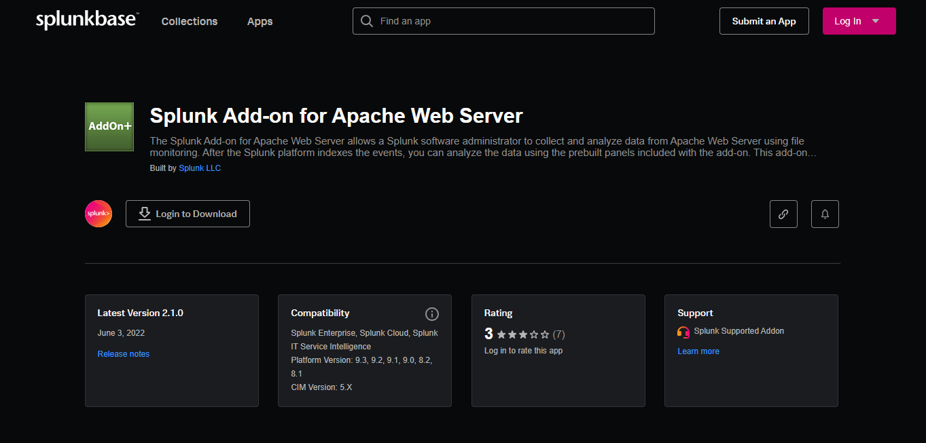
Splunk Add-On for Apache Web Server
“The Splunk Add-on for Apache Web Server allows a Splunk software administrator to collect and analyze data from Apache Web Server using file monitoring. After the Splunk platform indexes the events, you can analyze the data using the prebuilt panels included with the add-on.
This add-on provides the inputs and CIM-compatible knowledge to use with other Splunk apps, such as Web.” - Splunkbase.com
Notes:
JERRY

Slide 7
Splunk Add-On for Apache Web Server
Scenario in action:
Detecting Security Threats
A spike in HTTP POST requests is detected in real-time through a preconfigured dashboard created using Splunk add-on for Apache Web Server.
The logs show multiple unauthorized access attempts targeting the /admin URI from multiple foreign IPs.
Using Splunk's correlation with the Add-On data, we can identify this as a brute-force attack and immediately block any foreign IP’s.
Notes:
JERRY

Slide 8
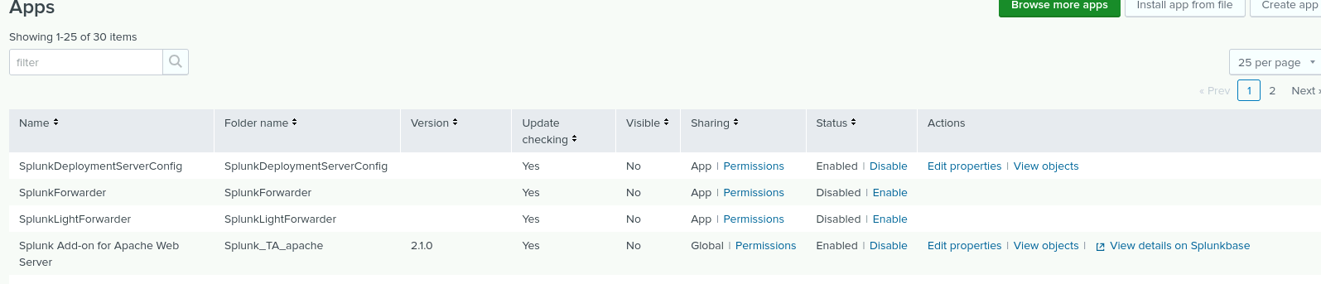
Splunk Add-On for Apache Web Server
Notes:
JERRY

Slide 9
Logs Analyzed
Windows Logs
Apache Logs
1
2
Windows logs capture events generated by the operating system and applications.
The add-on structures logs into meaningful categories like security, system, and application events.
It correlates data with Apache logs to detect broader attack patterns across infrastructure.
Apache logs record web server activity, including client requests, server responses, and error events.
The add-on automatically parses raw logs for meaningful fields like request method, referrer, and status codes.
It creates visualizations and alerts to detect anomalies like brute-force attacks or unauthorized access.
Notes:
BETH

Slide 10
Windows Logs
‹#›
Notes:
BETH

Slide 11
Reports—Windows
Designed the following reports:
Report Name | Report Description
Signatures and Signature IDs | Top value: “A user account was deleted”
Severity Levels | High = ~6%, Informational = ~93%
Windows Activities | 4000+ success, 142 failure
Event Code Statistics | Displays success/failure and count of various event codes
Notes:
BETH

Slide 12
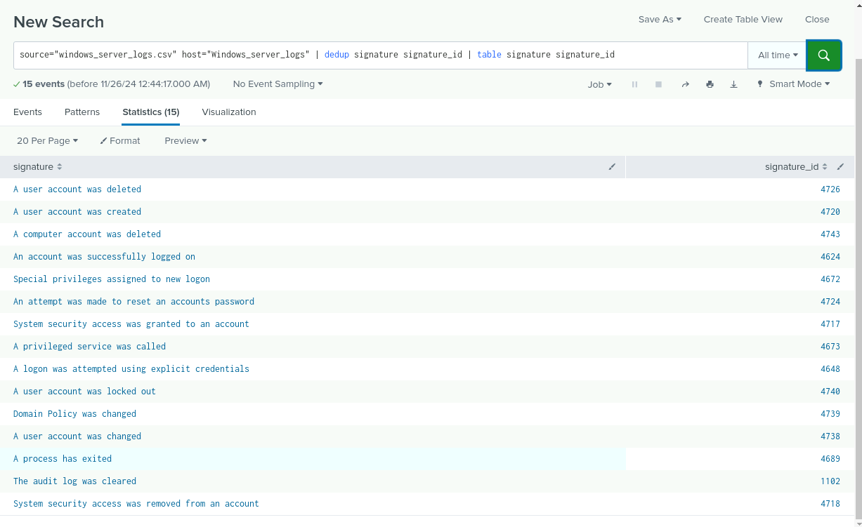
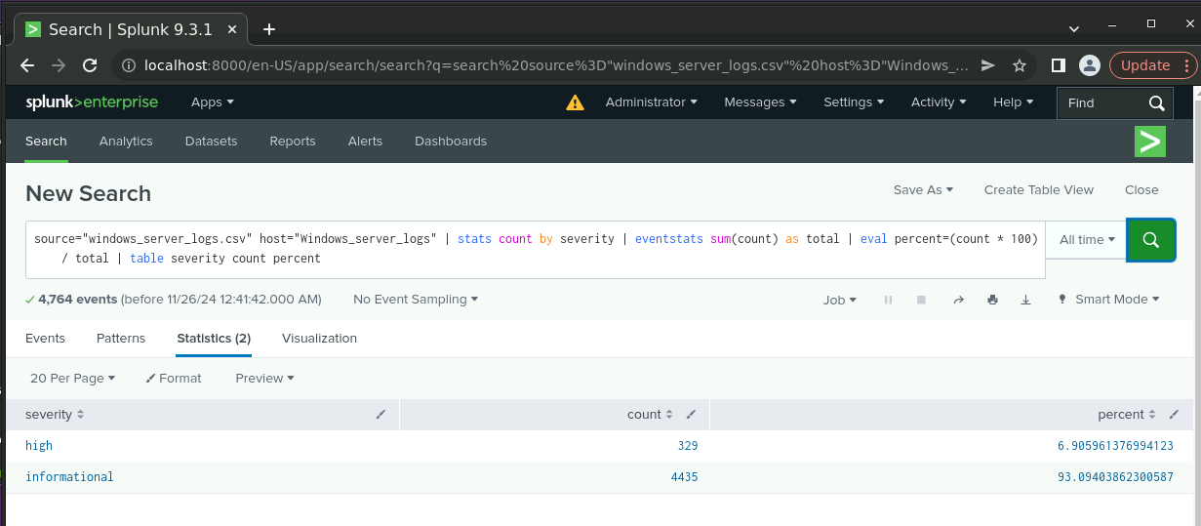
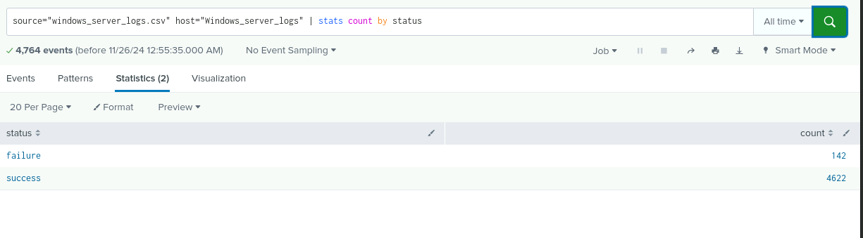
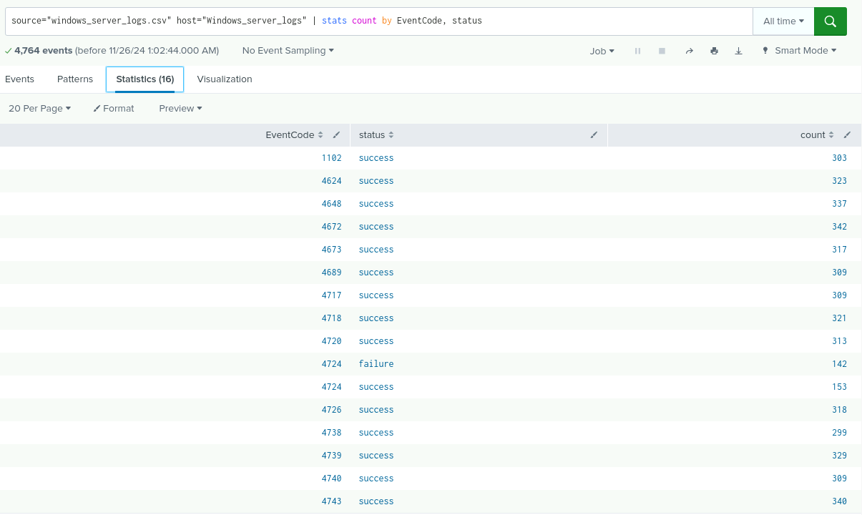
Images of Reports—Windows
Report Image
Report Image
Report Image
Report Image
Notes:
BETH

Slide 13
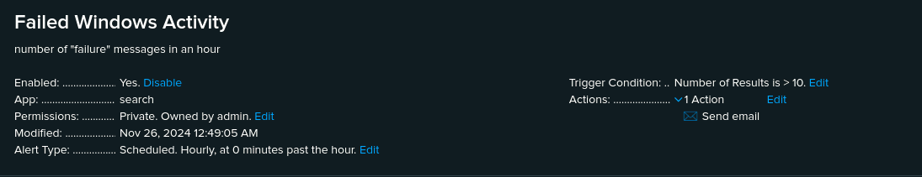
Alerts—Windows
Designed the following alerts:
Alert Name | Alert Description | Alert Baseline | Alert Threshold
Failed Windows Activity | number of “failure” messages in 1 hour | 5 | 10
JUSTIFICATION: The number of failures/hour had a slight variance, but the average was around 5, and it never went above 10.
Notes:
SHAWN

Slide 14
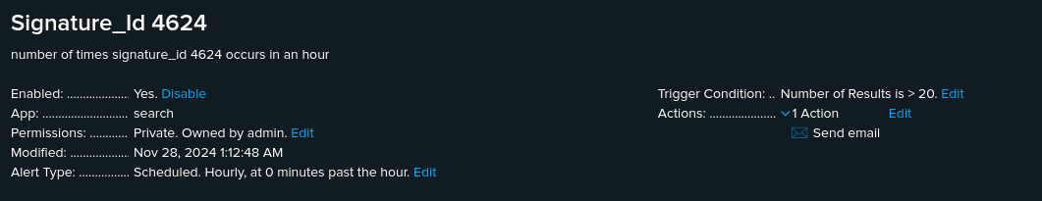
Alerts—Windows
Designed the following alerts:
Alert Name | Alert Description | Alert Baseline | Alert Threshold
Signature_Id 4624 | number of times signature_id 4624 appears in an hour | 12 | 20
JUSTIFICATION: This is the amount of times an account was successfully logged on. Still a bit of variance. The average was around 12 to establish the baseline. The max was 21, which only happened once. Everything else was 18 or lower, which made 20 seem like a solid threshold.
Notes:
SHAWN

Slide 15
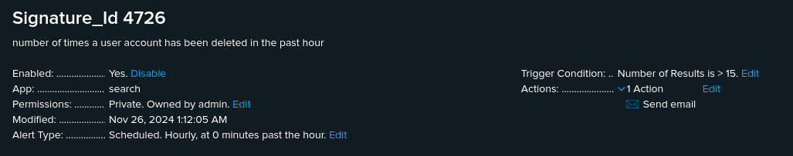
Alerts—Windows
Designed the following alerts:
Alert Name | Alert Description | Alert Baseline | Alert Threshold
Signature_Id 4726 | number of times a user account has been deleted in the past hour | 10 | 15
JUSTIFICATION: The average for this action was about 10 events/hour. This threshold was set fairly low, based on normal activity, but we felt that deleting a high number of accounts per hour carries its own inherent suspicions. 15 was exceeded a handful of times during the sample. This threshold is subject to change.
Notes:
SHAWN

Slide 16
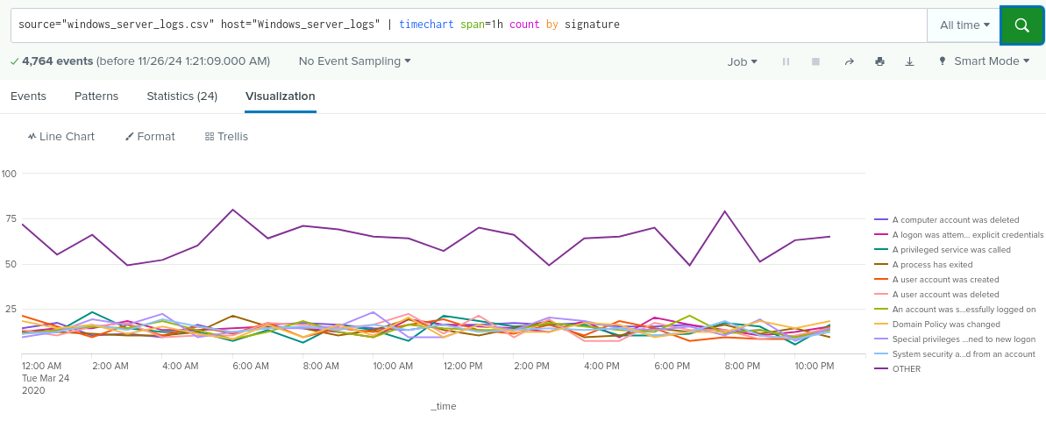
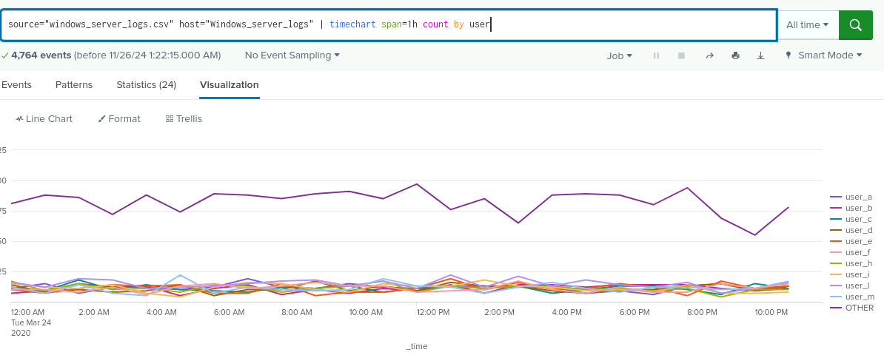
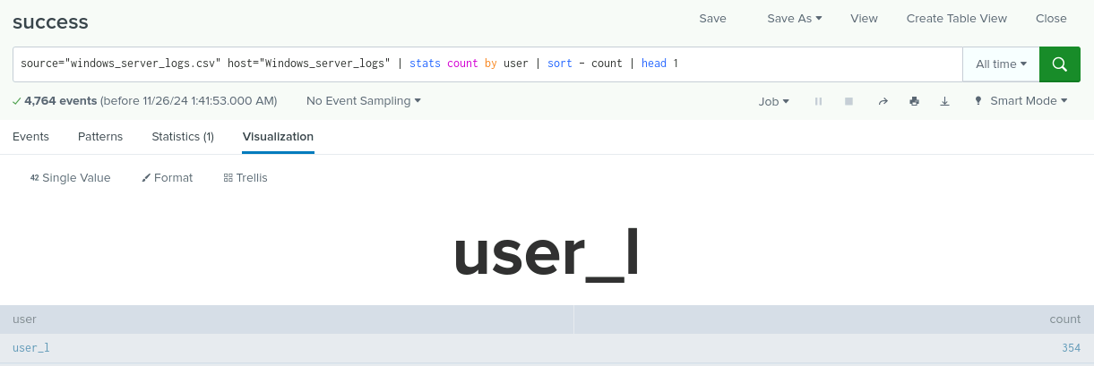
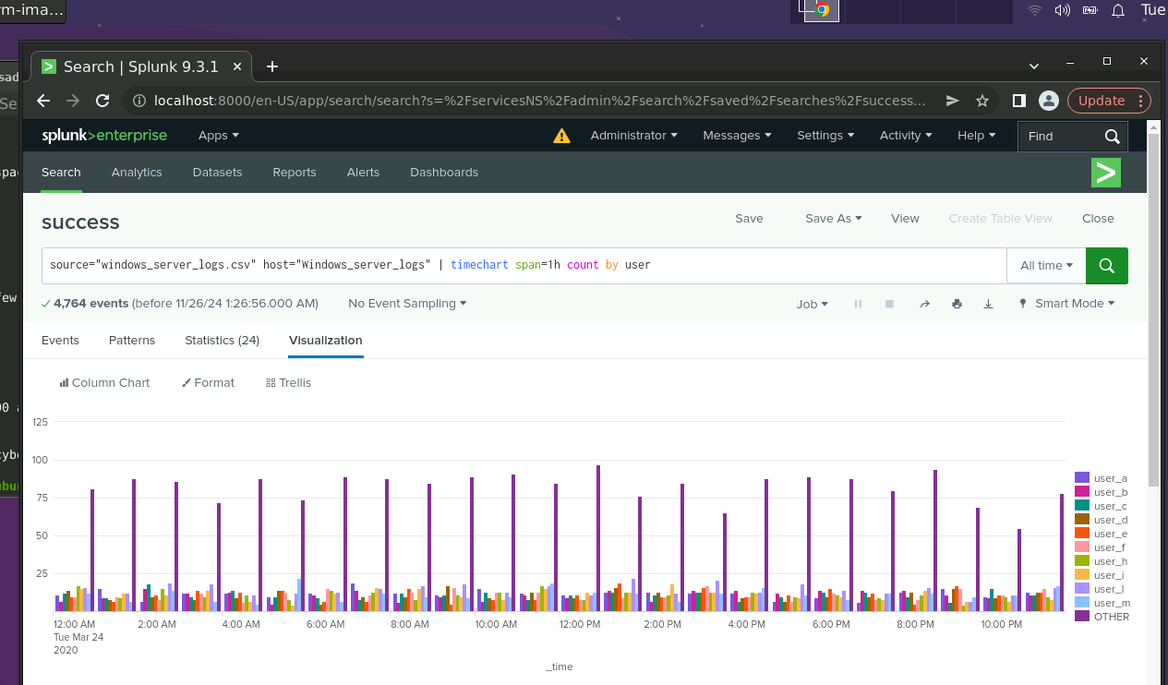
Dashboards—Windows
Place image here
Place image here
Place image here
Place image here
Notes:
MYLES

Slide 17
Apache Logs
‹#›
Notes:
BETH

Slide 18
Reports—Apache
Designed the following reports:
Report Name | Report Description
Referer Domain | Top result: semicomplete.com
HTTP Response | Top result: 200 “Ok”
HTTP Method | Top result: GET
Count by City | Large cluster in Northern Europe(most hits in Switzerland)
Notes:
BETH

Slide 19
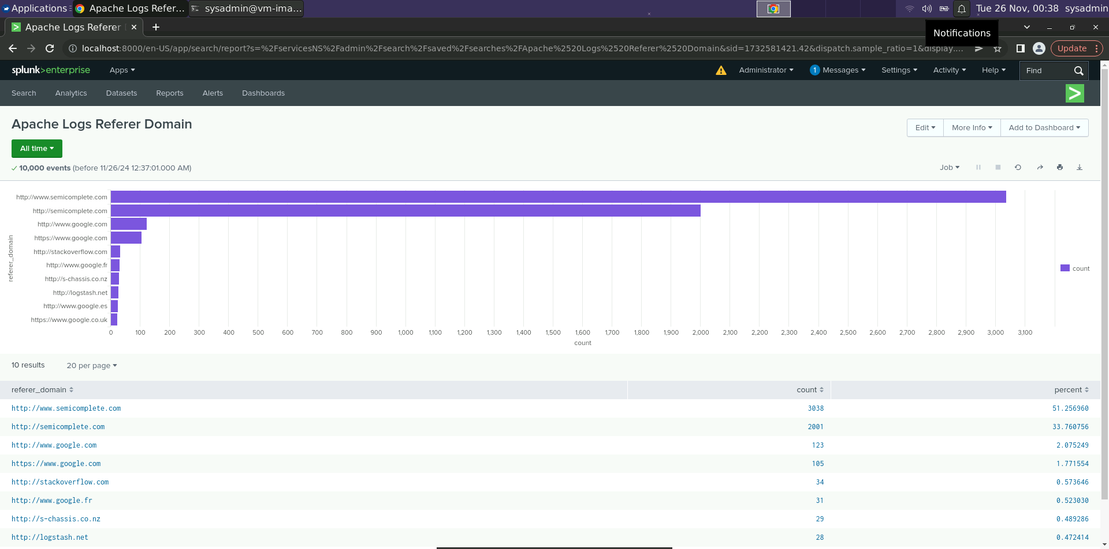
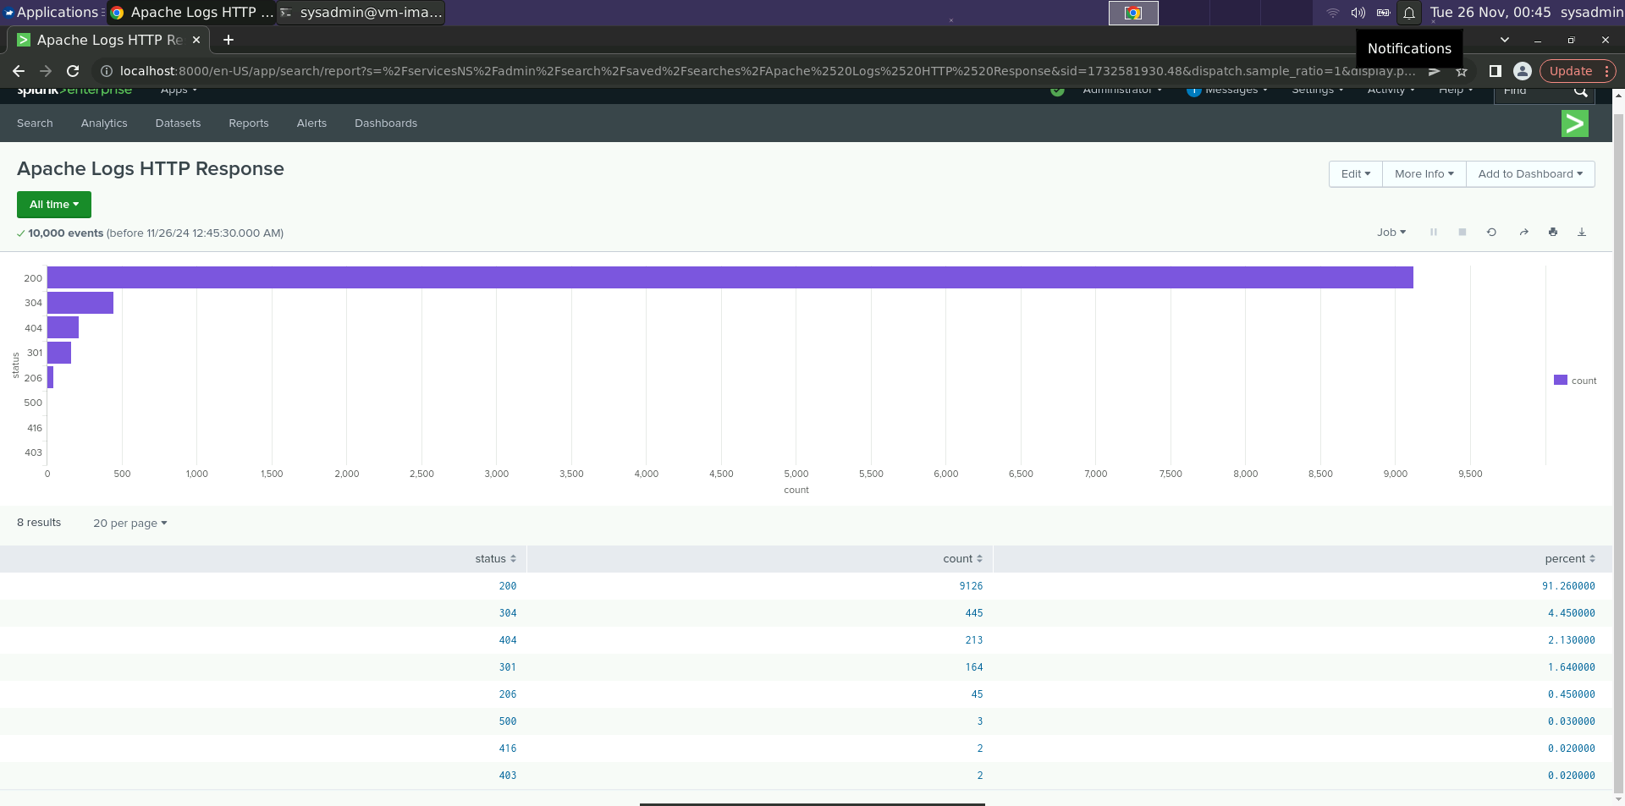
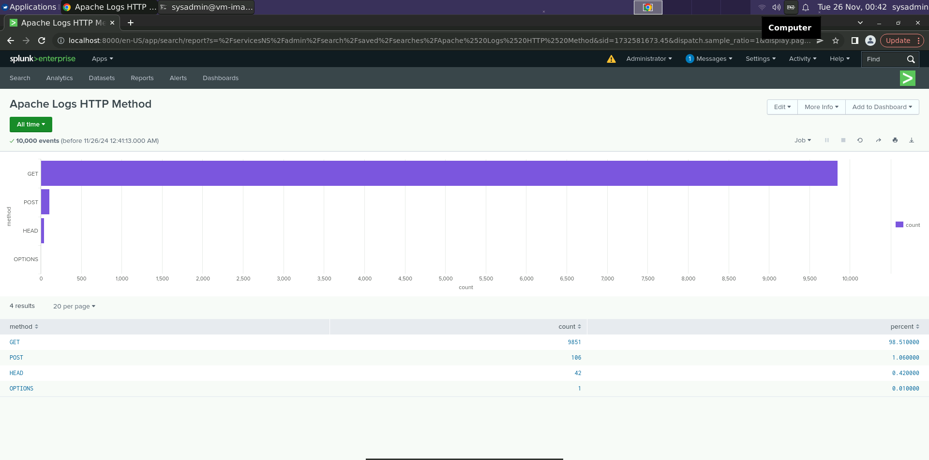
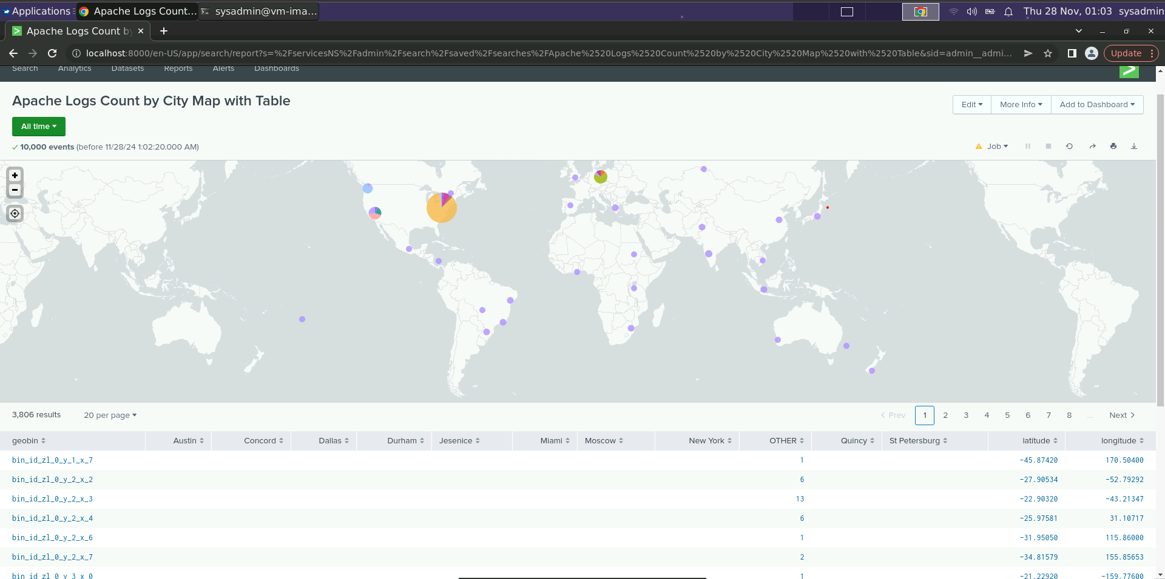
Images of Reports—Apache
Report Image
Report Image
Report Image
Report Image
Notes:
BETH

Slide 20
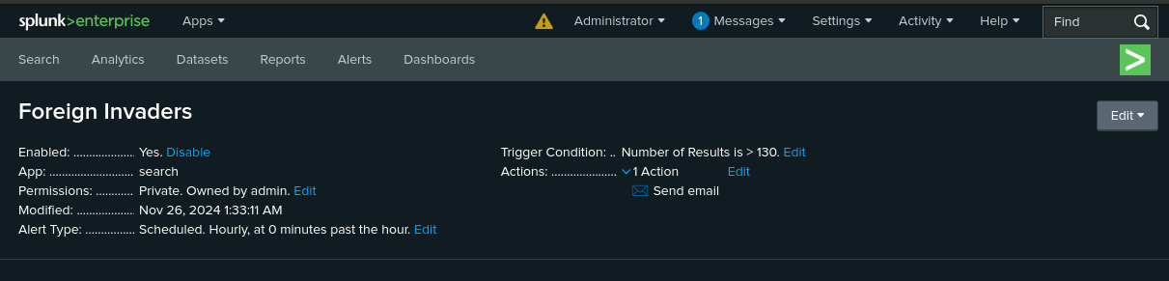
Alerts—Apache
Designed the following alerts:
Alert Name | Alert Description | Alert Baseline | Alert Threshold
Foreign Invaders | Activity outside USA | 72 | > 130
JUSTIFICATION: Most values averaged approximately 72 events per hour, with spikes close to 130.
Notes:
MYLES

Slide 21
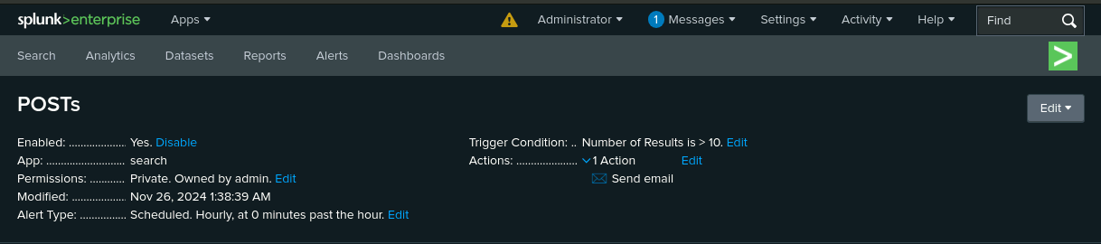
Alerts—Apache
Designed the following alerts:
Alert Name | Alert Description | Alert Baseline | Alert Threshold
POSTs | Count of POST method | 2 | > 10
JUSTIFICATION: Most values averaged around 2-3 events per hour, with spikes close to 10.
Notes:
MYLES

Slide 22
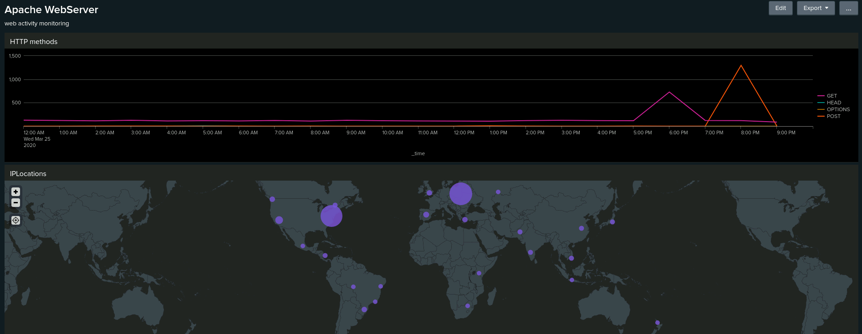
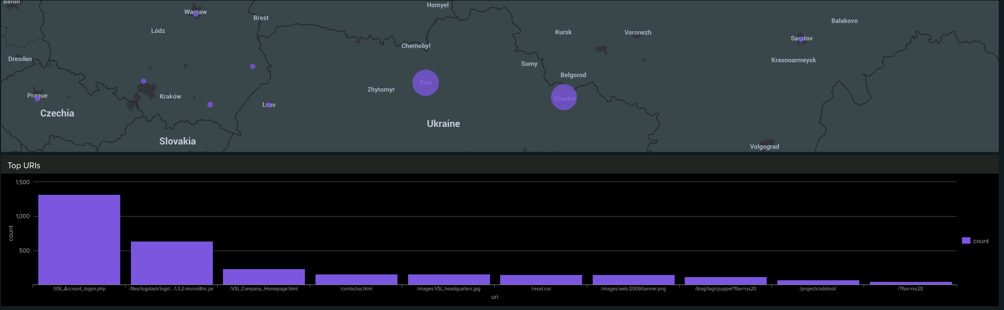
Dashboards—Apache
Place image here
Place image here
Place image here
Place image here
Notes:
Nick Long’s Slide

Slide 23
Attack Analysis
‹#›
Notes:
Nick

Slide 24
Attack Summary—Windows
Summarize your findings from your reports when analyzing the attack logs.
There was a spike in activity on March 25th, 2020 from 1am - 2am, and then again from 9am - 10am
At 1am there was a major spike in accounts being locked out
At 2am there was a continued spike in lockouts, along with another spike in attempts to reset account passwords
At 9am there was another spike in account passwords being reset
At 10am there was a high amount of successful logons that triggered an alert
Notes:
Nick Long’s Slides

Slide 25
Attack Summary—Windows
Summarize your findings from your alerts when analyzing the attack logs. Were the thresholds correct?
Every threshold that we set would have triggered an alert
Notes:
Nick Long’s Slides

Slide 26
Attack Summary—Windows
Summarize your findings from your dashboards when analyzing the attack logs.
Each of the parameters set for analysis showcased clear cases of large spikes in activity during concerning hours.
Notes:
Nick Long’s Slides

Slide 27
Attack Summary—Apache
Summarize your findings from your reports when analyzing the attack logs.
A Shift of 29% from GET to POST
A Jump of 13% in 404 response codes
These findings combined suggest an attempted code insertion with intention of causing DOS.
Notes:
Nick Long’s Slides

Slide 28
Attack Summary—Apache
Summarize your findings from your alerts when analyzing the attack logs. Were the thresholds correct?
Alerts were properly configured and worked as intended to draw attention to suspicious activity ^{taylor}swiftly.
Notes:
Nick Long’s Slides

Slide 29
Attack Summary—Apache
Summarize your findings from your dashboards when analyzing the attack logs.
Dashboards were instrumental in creating clear visualizations which necessary in convincing executives (notoriously adverse to reading) that action should be taken to harden systems against future attack attempts.
Notes:
Nick Long’s Slides

Slide 30
Summary and Future Mitigations
‹#›
Notes:
JERRY

Slide 31
Project 3 Summary
What were your overall findings from the attack that took place?
An attacker in Ukraine was able to successfully gain access to the servers through a brute force attack.
To protect VSI from future attacks, what future mitigations would you recommend?
enable MFA
require strong passwords
implement rate limiting to control the number of requests from a single IP address
Notes:
JERRY

